Slide 1


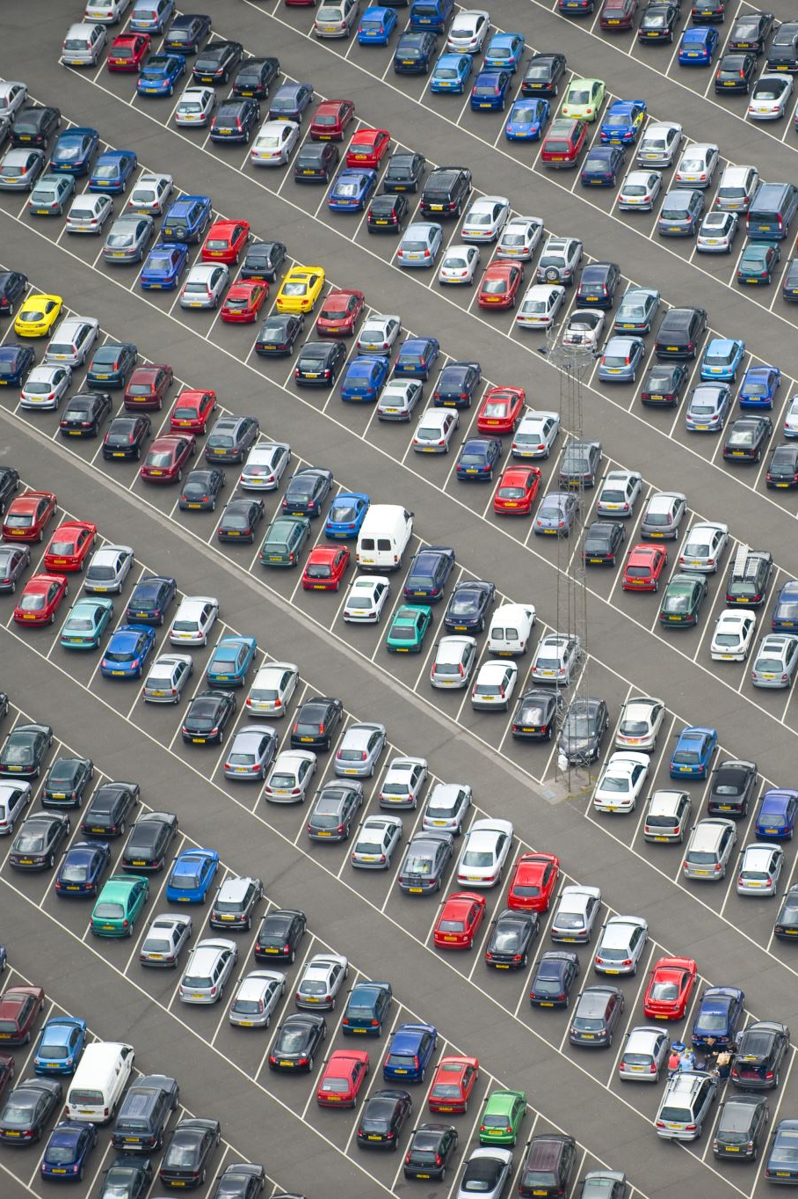
FORECASTING THE VALUE OF PRE-OWNED VEHICLES

Slide 2

INTRODUCING OUR TEAM
Chaitanya Gopinadh Madala
Divya Mamuru
Saikumar Dacharla
Nikhith Krishna Vinduru

Slide 3
THE PROBLEM
The pre-owned vehicle market is characterized by dynamic pricing influenced by factors such as make, model, age, mileage, condition, geographical location, and market trends. Accurate and timely valuation of used vehicles is crucial for both buyers and sellers in making informed decisions.
This project include dealing with missing or incomplete data, normalizing various data formats, and selecting relevant features that significantly impact the valuation. Additionally, the model should be scalable to handle a high volume of queries in real-time.
GitHub link : https://github.com/orgs/SaiDivyaKrishnaChai/teams

Slide 4

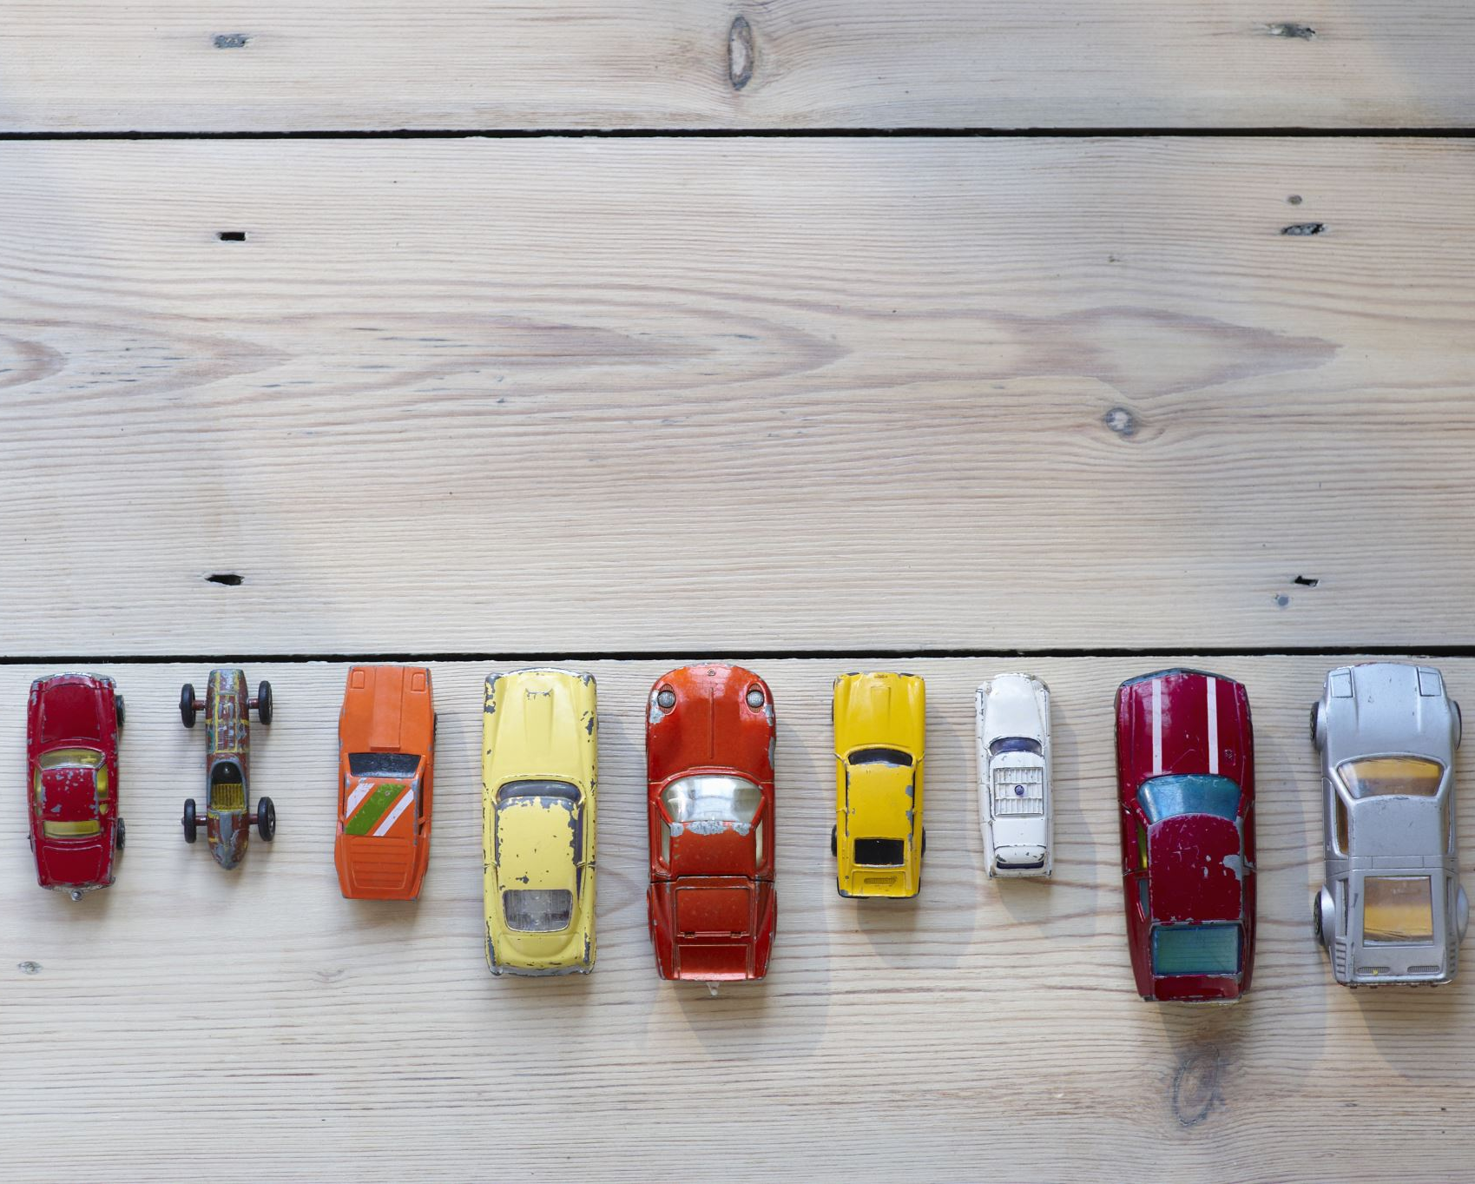
BUSSINESS GOAL
We have to use the provided independent variables to model the cost of cars. The management will use it to comprehend the precise relationship between price variation and independent variables. In order to maintain a set pricing, they can adjust the car's design, the company's marketing plan, etc. The tool will also help management better understand how prices change in a new market.

Slide 5

INTRODUCTION
In an ever-evolving automotive market, accurately determining the value of pre-owned vehicles stands as a pivotal challenge for both buyers and sellers. The dynamic interplay of factors such as make, model, age, mileage, condition, and location intricately influence the market worth of a vehicle. This project embarks on the mission to develop a cutting-edge solution that navigates through this intricate landscape.
By leveraging advanced data engineering techniques and machine learning algorithms, we aim to provide a robust and reliable tool for estimating the value of pre-owned vehicles. This solution promises to bring transparency and informed decision-making to the pre-owned vehicle market, benefitting buyers and sellers alike.

Slide 6
INTRODUCTION CONTINUED…
In this pursuit, we will meticulously gather and process data from a diverse array of sources, including historical sales records, online listings, manufacturer specifications, and real-time market trends. This data will then be transformed into a cohesive format, setting the stage for training our forecasting model.
With a sharp focus on selecting relevant features, we will distill the most essential elements that have a substantial impact on vehicle valuation. These insights, combined with the power of advanced machine learning algorithms, will empower us to construct a model capable of precisely predicting the value of pre-owned vehicles.

Slide 7
TECHNOLOGIES
These are the technologies we are planning to use to achieve the goal.
Python 3.7
Jupyter Notebook
Flask Framework
HTML
CSS
JS
Aws Cloud

Slide 8

SOLUTION
In this Project, we are going to predict the Price of Used Cars using various features like Present_Price, Selling_Price, Kms_Driven, Fuel_Type, Year etc. The data used in this project was downloaded from Kaggle.So as we try diferent Regression Alorithms and found that "GBT Regressor Model"* is giving better accuracy compare to other.

Slide 9

SUMMARY
This Project is aimed to develop a model to predict the prices of used cars. The results of the model helps to determine the important factors while predicting the prices of the used cars. Using the dataset available in the Kaggle, will develop a data analysis model to achieve the accuracy. The importance of the features are determined using feature extraction done by a data analysis model. Some of the important features that does help in deciding the prices are YEAR, Engine Size, MPG and Mileage.

Slide 10
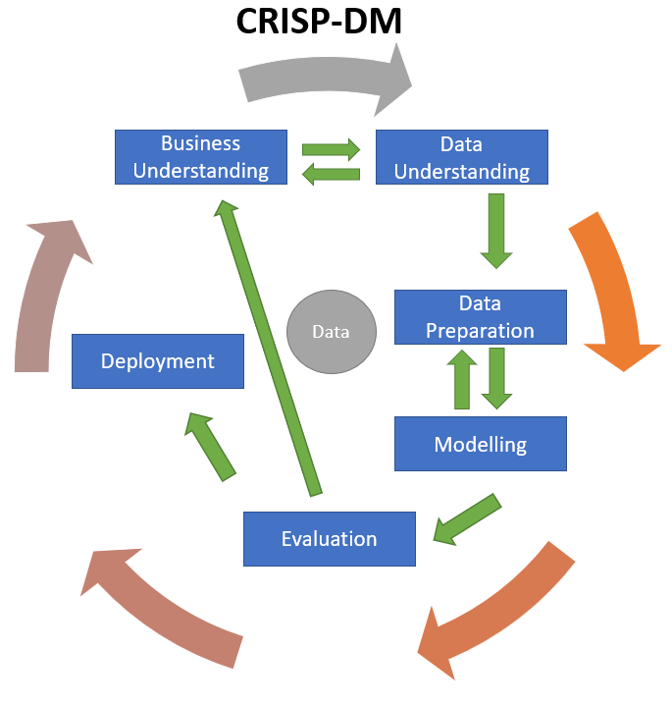
Methodology

Slide 11
THANK YOU

